Slide 1
AFRICA SME PROGRAM
UNLUCK FINANCING FOR RESISIELNCE, INCLUSIVE GROWTH AND JOB CREATION

Slide 2
Africa SME Program Strategy
Poverty alleviation Increasing socioeconomic resilience Sustainable development to tackle the root causes of migration
IMPACT
Creating 44 000 direct jobs and 132 000 indirect jobs 30% of job opportunities dedicated to women to promote gender inclusion Scaling up youth entrepreneurship
OUTCOMES
EUR 410 M Local Currency mobilized to support 21 500 Africa MSMEs Local tier II/III Financial Institutions and SMEs provided with adequate training
OUTPUTS
Deployment of innovative financial instruments, using blended finance mechanisms: EUR 20M EC guarantee, EUR 3,7M TA funding, EUR 130M AfDB commitment through guarantee and funding
INPUT

Slide 3
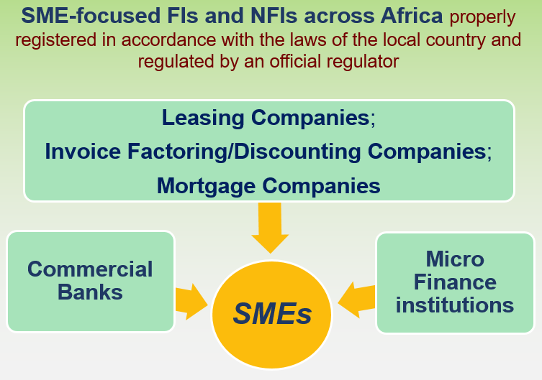
REACH SMEs THROUGH FINANCIAL INTERMEDIARIES
The program’s objective is to enhance access to finance for small and medium-sized enterprises through local Financial Institutions.
Financial support to medium and smaller-sized (tier 2 and tier 3) Financial Institutions (FIs) and Non-Financial Institutions (NFIs), increasing their on-lending capacity, at competitive terms, to SMEs.

Slide 4
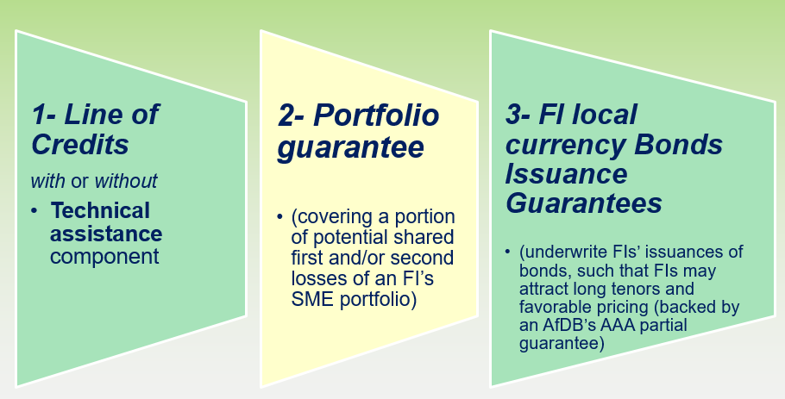
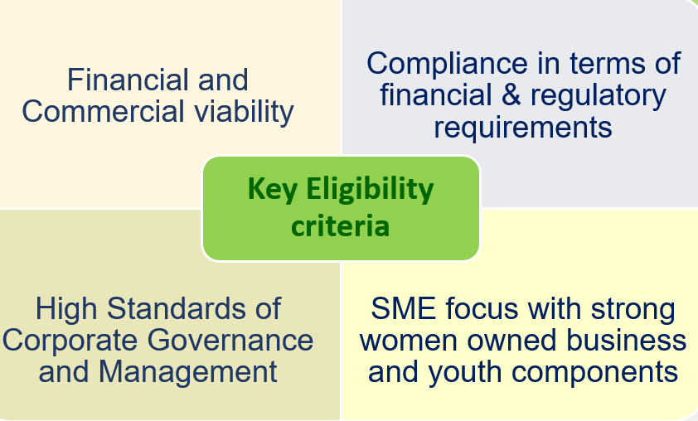
COMPLETE RANGE OF PRODUCT

Slide 5
ELIGIBILITY CRITERIA
For financial intermediaries
For SMES
- criteria set by BEAC for SMEs to access credit from local
financial intermediaries
- additional criteria as required by local financial intermediaries

Slide 6
ELIGIBILITY CRITERIA
For financial intermediaries
For SMES
- criteria set by BEAC for SMEs to access credit from local
financial intermediaries
- additional criteria as required by local financial intermediaries

Slide 7
AFRICA SME PROGRAM IN CAMEROUN
Ongoing discussions with one local financial institution to deploy the program to the benefit of local SMEs
Ongoing discussions with one regional banking player to to deploy the program to the benefits of SMEs in the CEMAC region including Cameroun
How to Apply / Contacts at AfDB:
Suzanne EKEDI DIBOUNDJE,
African Developement Bank
Investment Officer
Financial Inclusion & Intermediation
Email: S.EKEDIDIBOUNDJE@AFDB.ORG
Tel : +225 2026 4364
M. M’Para COULIBALY
African Developement Bank
Senior Investment Officer
Financial Inclusion & Intermediation
Email: I.COULIBALY@AFDB.ORG
Tel : +225 2026 4383

Slide 8
TARGET AUDIENCE
Direct audience: African regulated Financial Institution may submit application for the benefit of group of SMEs
Indirect audience: African SMEs, to be put in contact with beneficiaries local Financial Institutions
How to Apply / Contacts at AfDB:
Suzanne EKEDI DIBOUNDJE,
African Developement Bank
Investment Officer
Financial Inclusion & Intermediation
Email: S.EKEDIDIBOUNDJE@AFDB.ORG
Tel : +225 2026 4364
M. M’Para COULIBALY
African Developement Bank
Senior Investment Officer
Financial Inclusion & Intermediation
Email: I.COULIBALY@AFDB.ORG
Tel : +225 2026 4383

Slide 9
THANK YOU

